Slide 1
Cayman Islands National Museum
Presents

Slide 2
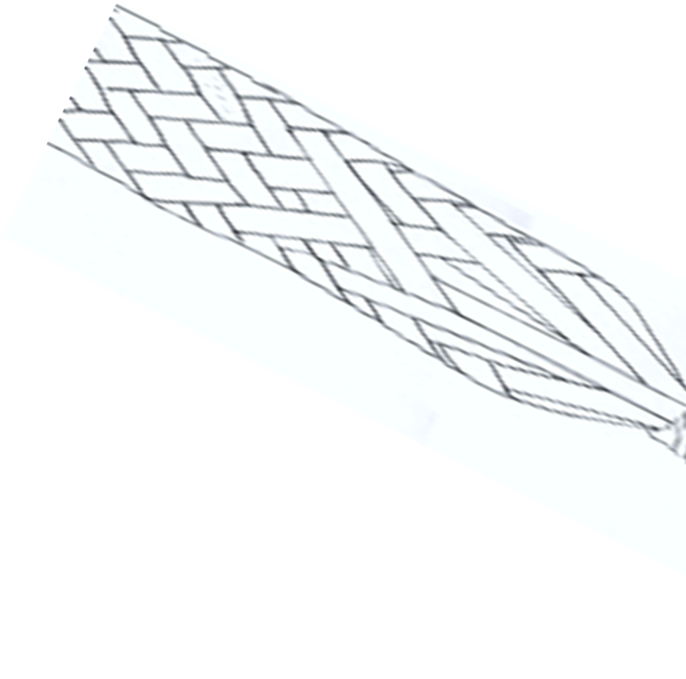
The SILVER THATCH PALM
The National Museum currently stewards a growing collection of objects of vintage, modern, and contemporary crafts from 1960s to the present.
The Collection also includes works in clay, glass, metal and wood, mid-late century thatch and caymanite.
And The Caymanian Basket

Slide 3
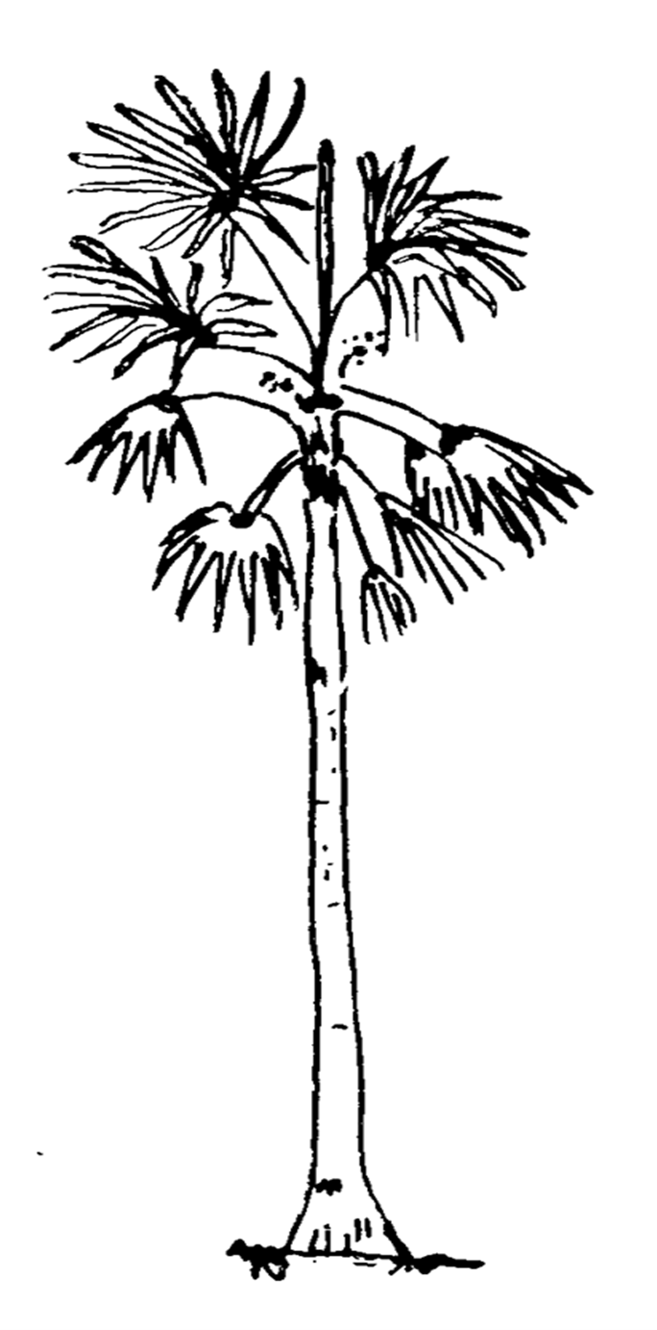
What’s in a name? Silver Thatch Palm
For many years, we depended on our own ingenuity to create vital items by hand from raw materials rising tens of feet from rich soil in the dry evergreen forest woodlands or the wet marshes.
.

Slide 4
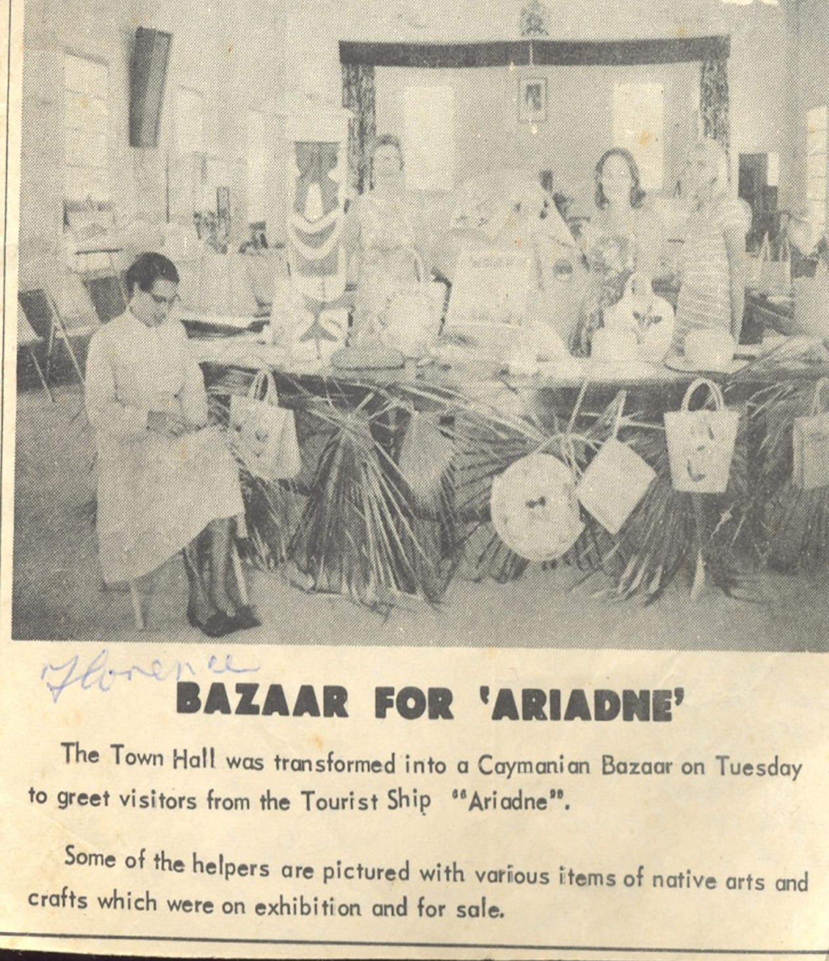
The hats are not artistic creations but they are very serviceable.
Commissioner Hirst, 1908

Slide 5
CAYMAN Thatch
The Silver Thatch Palm, Coccothrinax proctorii, is a useful ornamental tree endemic to the Cayman Islands. The palm grows in sandy soil or, in pockets of soil along cliffy terrain; can grow up to 30 feet.
In 1910 alone, we exported more than any 873,000 fathoms of rope to Jamaica.

Slide 6
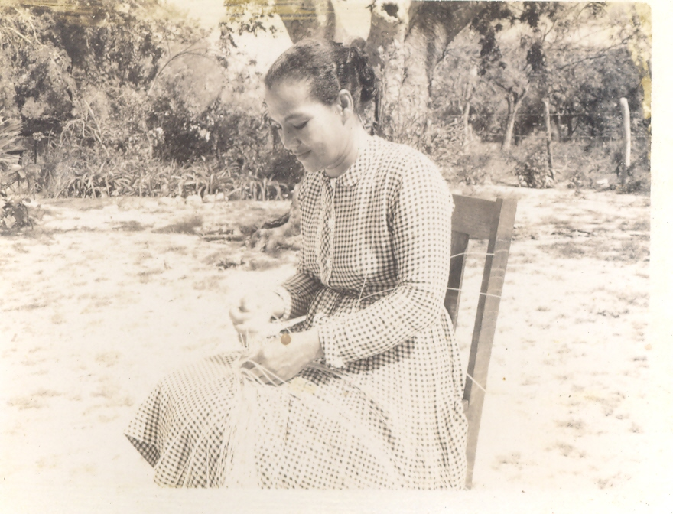
Until only a few decades ago thatch palm, for instance, was an essential raw material. From it we made roofs, rope, baskets, hats, handbags, fans, brooms and other necessities.
Florence Tatum Plaiting at home, West Bay, 1955. Photo courtesy of B. Tony Powell
Most baskets are made with 7, 11, and 15 strings.

Slide 7
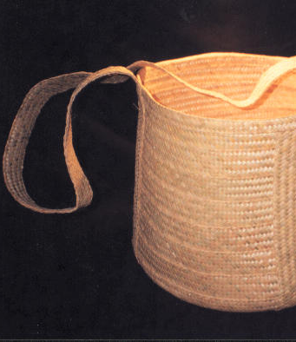
Ground Basket
Traditional Plait and Sew
Silver Thatch Ground Basket
Dimensions:
28” h x 24”d
Artisan:
Esther Ebanks,
West Bay

Slide 8
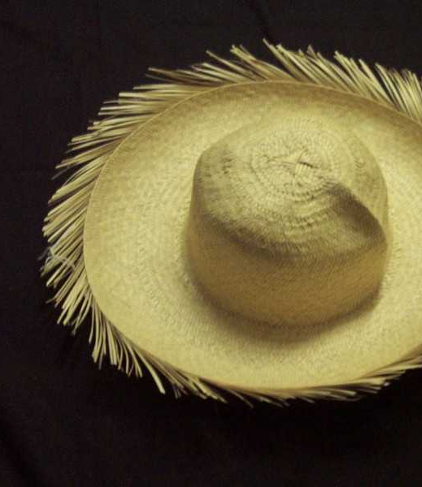
Hat
Plait and Sew
Silver Thatch Palm
Turtler’s Hat
Dimensions:
8” h x 18”d
Artisan:
Roosevelt Rankin
East End

Slide 9
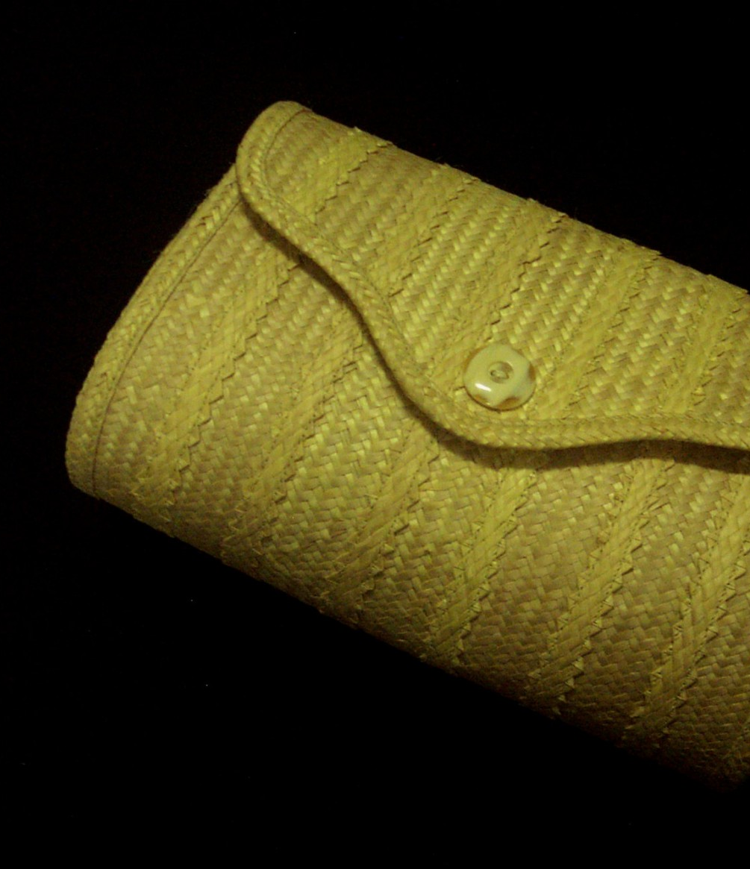
Purse
Plait and Sew
Silver Thatch Palm Purse
with Button Snap.
Dimensions:
5” l x 10”w x 4”h
Artisan:
Adelaide Ebanks,
North Side

Slide 10
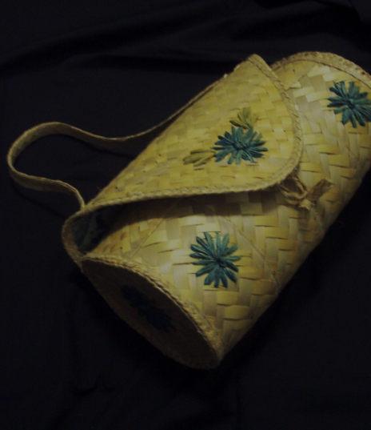
Purse
Plait and Sew
Silver Thatch Palm
Dimensions:
5” l x 10”w x 4”h
Artisan:
Colleen Gibson
West End

Slide 11
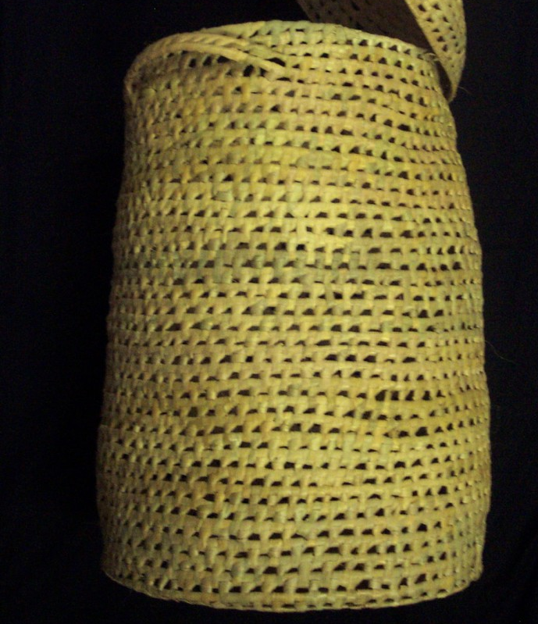
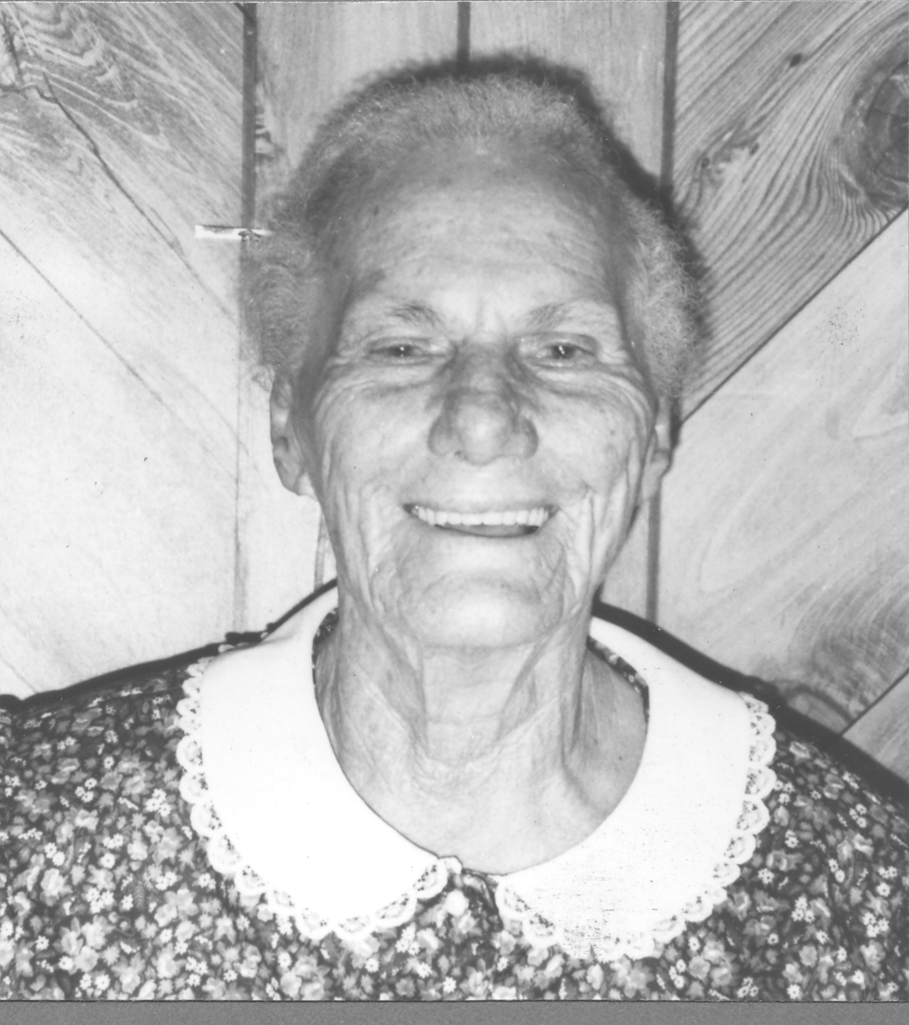
Hamper
Twist Strand
Silver Thatch Palm Hamper
with Lid and Handles.
Dimensions:
36” h x 18”d
Artisan:
Adinah Ebanks
North Side

Slide 12
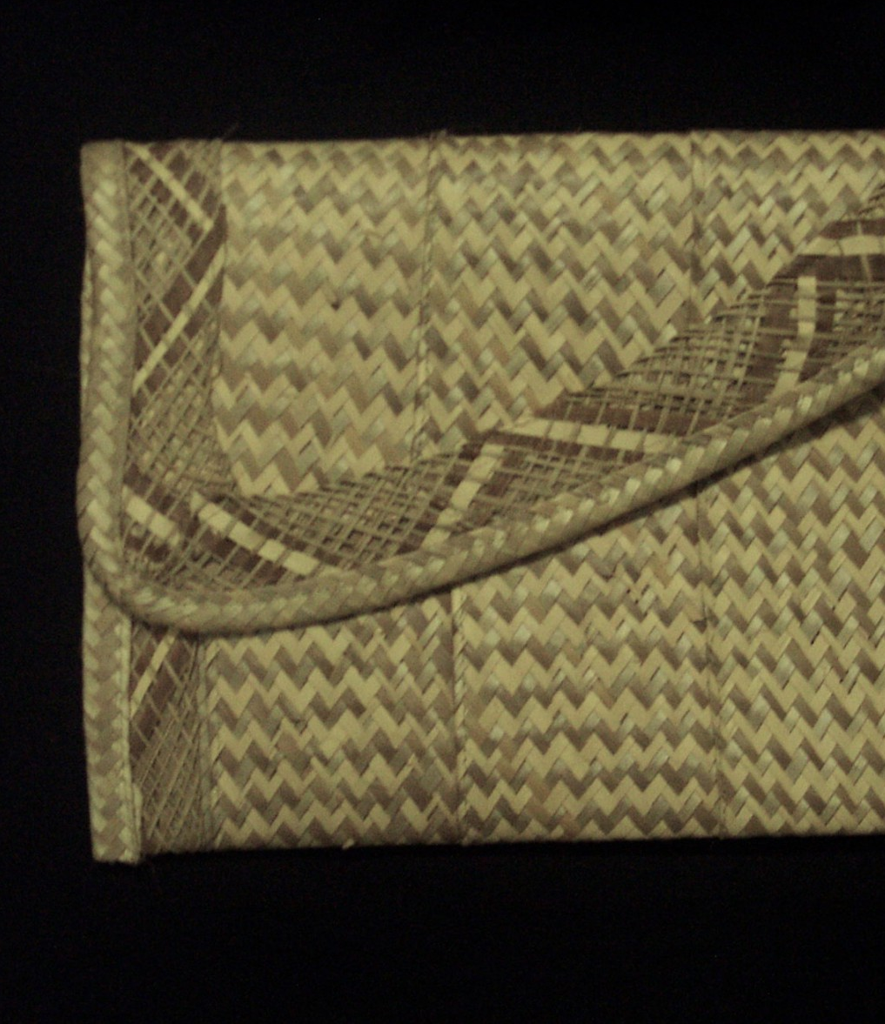
Purse
Plait and Sew
Silver Thatch Palm Clutch Handbag
Dimensions:
6” h x 12”w x 1”h
Artisan:
Adelaide Ebanks
North Side

Slide 13
Tote Bag
Plait and Sew
Silver Thatch Palm Tote Bag
Dimensions:
12” l x 10”w x 5”d
Artisan:
Grashala Solomon
East End

Slide 14
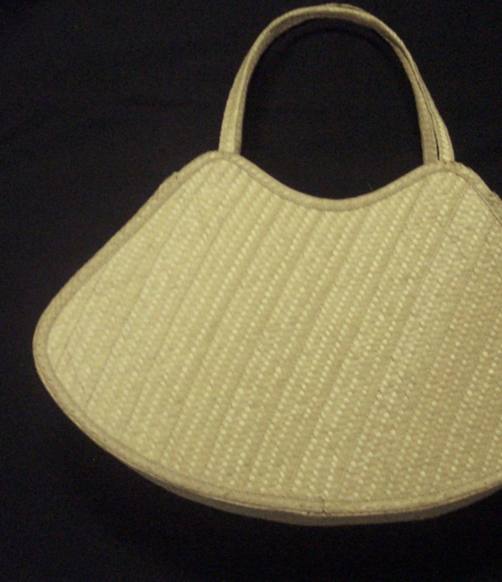
HandBag
Plait and Sew
Silver Thatch Palm Handbag
Dimensions:
36” h x 18”d
Artisan:
Carmen Conolly
East End

Slide 15
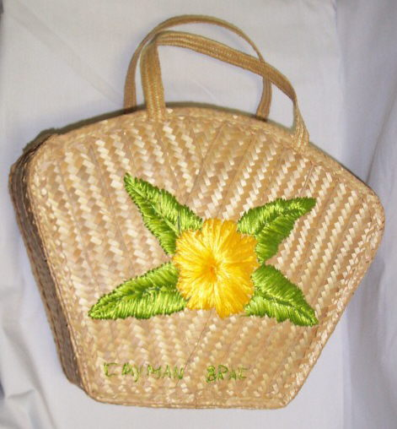
HandBag
Plait and Sew
Silver Thatch Palm Handbag
Dimensions:
18” h x 18”d
Artisan:
Annelee Ebanks
Cayman Brac

Slide 16
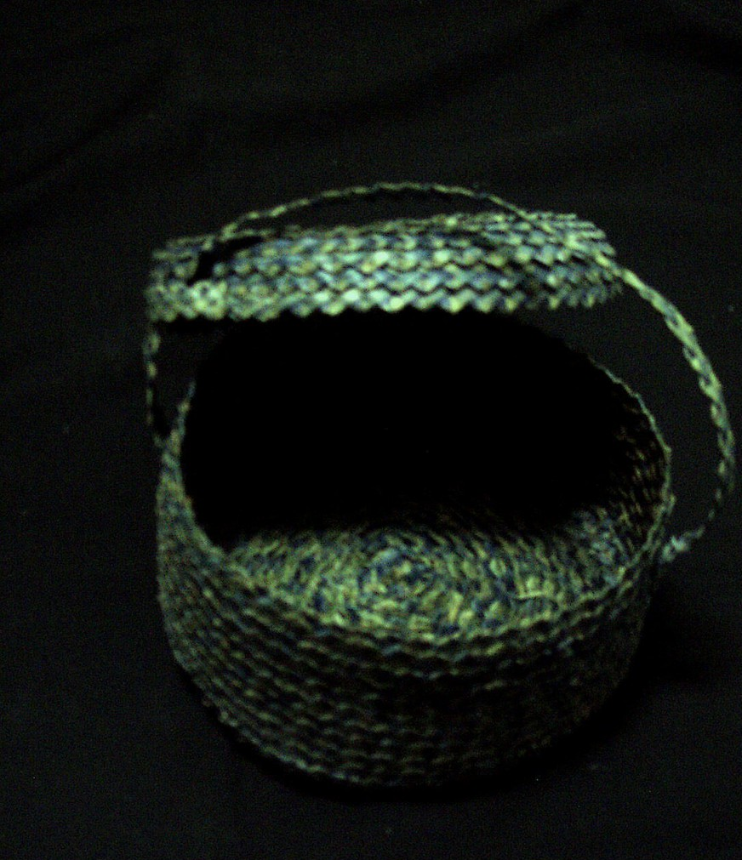
Jewel box
Plait and Sew
Silver Thatch Palm
Jewel Box
Dimensions:
6”D x 3”H
Artisan:
RoseMay Ebanks
West Bay

Slide 17
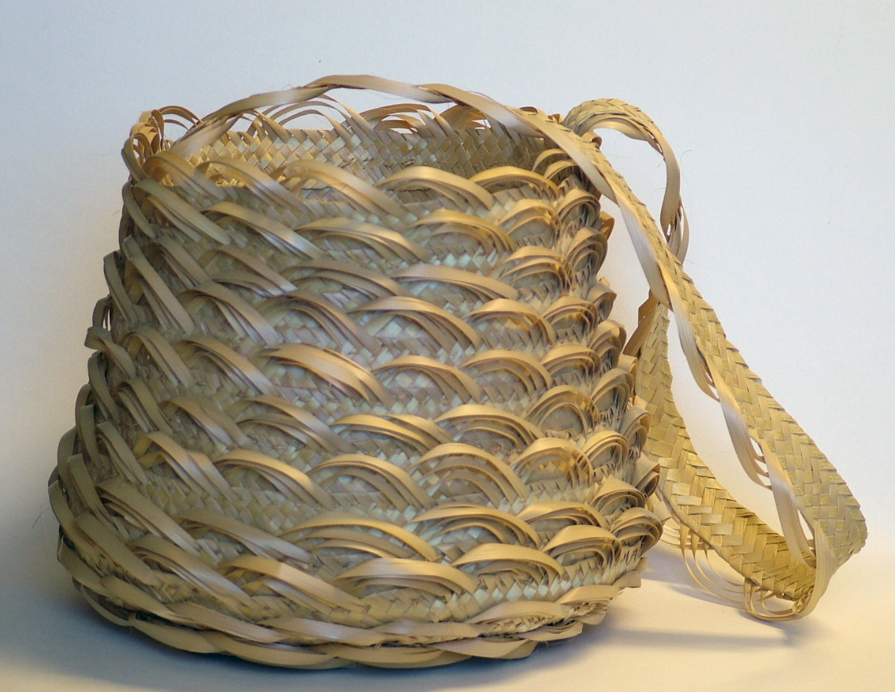

Slide 18
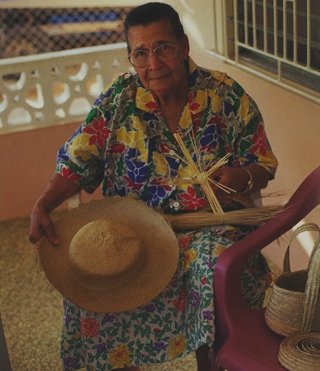
Master Artisan
Beatrice Dilbert (Deceased)

Slide 19
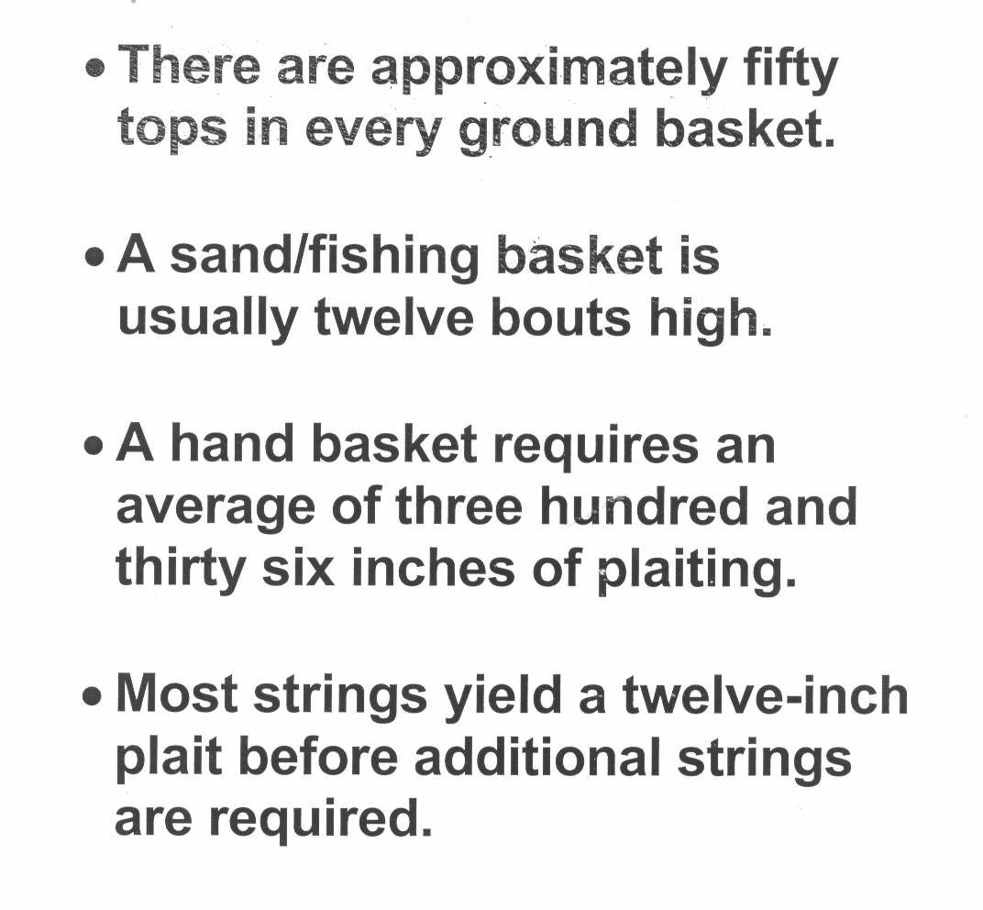
FACTOIDs
Caymanian Basketry

